Slide 1
MULTI CHANNEL DATA ACQUISITION SYSTEM
PROJECT BY,
G CHETHANA 12AQ1A0424
CH SIRIVANTH SINGH 12AQ1A0420
G RAJ KUMAR 12AQ1A0426
D VENKATESH 12AQ1A0421

Slide 2
ABSTARCT
Process control is an efficient means of improving the operation of a process, the productivity of a plant, and the quality of products. Even a small improvement in the operation of a process can have great economic and environmental influences.
This project deals with development of multi channel analog data through PC. It uses an ADC acd0808 to convert from analog to digital. A micro controller to control the ADC and send data to mobile at a baud rate of 9600, and a MAX232 chip to convert the RS232 signal. The ADC0808 and the ADC0809 each consist of a analog signal multiplexer, 8 bit converter and related control and output circuitry.
Software will be developed in KEIL software for AT89c51 micro controller for ADC interface.

Slide 3
INDEX
OBJECTIVE
INTODUCTION
BLOCK DIAGRAM
MODULES-MCU,PSU,MAX232 ,SIGNAL CONVERTER,SENSOR,LDR,TIMER
FLOW CHART
SCHEMATIC
RESULT
APPLICATIONS
ADVANTAGES/DISADVANTAGES
FUTURE SCOPE

Slide 4
OBJECTIVES
Data acquisition is the process of sampling signals that measure real world physical conditions and converting the resulting samples into digital numeric values that can be manipulated by a computer. The present device control system can be used for different sophisticated home applications.
The control system consists of android mobile control circuitry and the electrical devices. The intelligent control software which has been developed using high level graphic programming language.
The device is fully controlled by commands from mobiles.

Slide 5
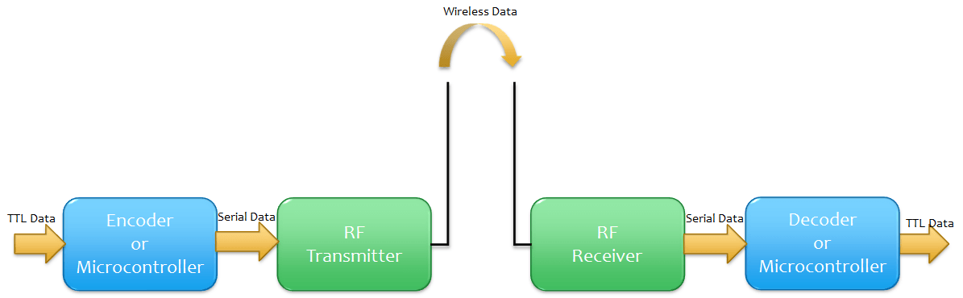
INTRODUCTION
An Embedded System is a combination of computer hardware and software.
They are designed to do some specific task, rather than be a general-purpose computer for multiple tasks.
RTS, In simple terms, a real-time system is partly specified in terms of its ability to make certain, Operation or decisions in a timely manner

Slide 6
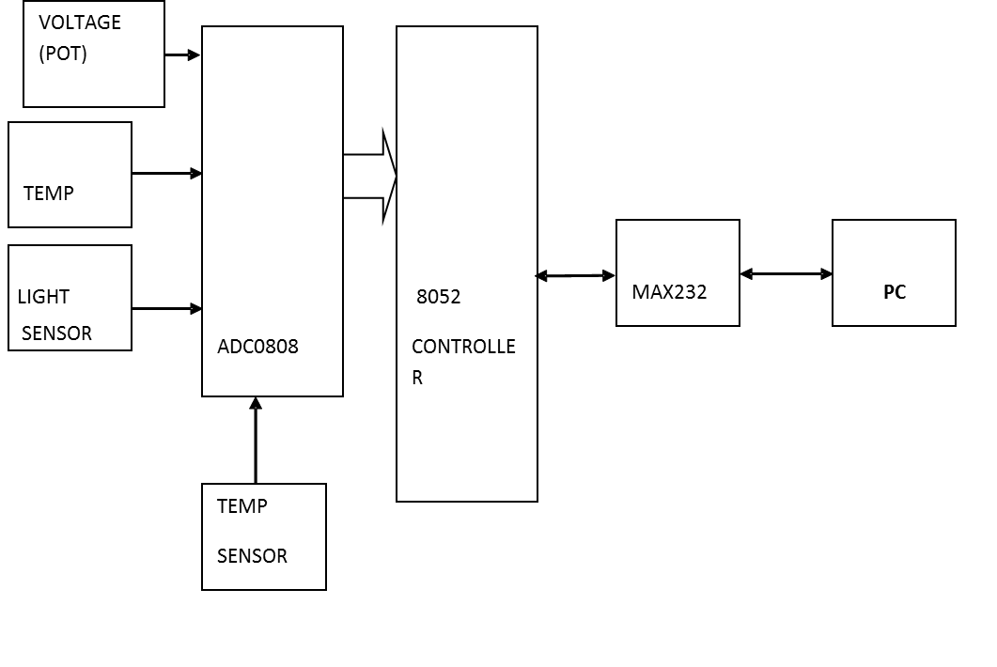
Block Diagram of Multi Channel Data Acquisition System

Slide 7
MODULES USED IN OUR PROJECT
MICRO CONTROLLING UNIT (MCU)
POWER SUPPLY UNIT (PSU)
SIGNAL CONVERTER MAX232
TEMPERATURE SENSOR
LDR
ADC0808
555TIMER

Slide 8
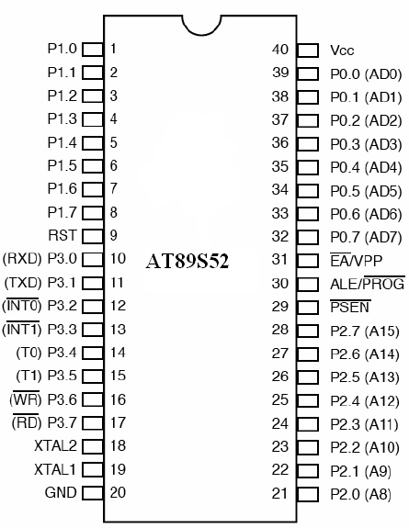
Features and Pin diagram of AT89S52
Few Features of AT89S52 :
Compatible with MCS®-51 Products
8K Bytes of In-System Programmable (ISP) Flash Memory
Endurance: 10,000 Write/Erase Cycles
4.0V to 5.5V Operating Range
Fully Static Operation: 0 Hz to 33 MHz
Three-level Program Memory Lock
256 x 8-bit Internal RAM
32 Programmable I/O Lines
Three 16-bit Timer/Counters
Eight Interrupt Sources
Full Duplex UART Serial Channel
Low-power Idle and Power-down Modes
Interrupt Recovery from Power-down Mode
Watchdog Timer
Dual Data Pointer
Power-off Flag
Fast Programming Time
Flexible ISP Programming (Byte and Page Mode)
(Pb/Halide-free) Packaging Option

Slide 9

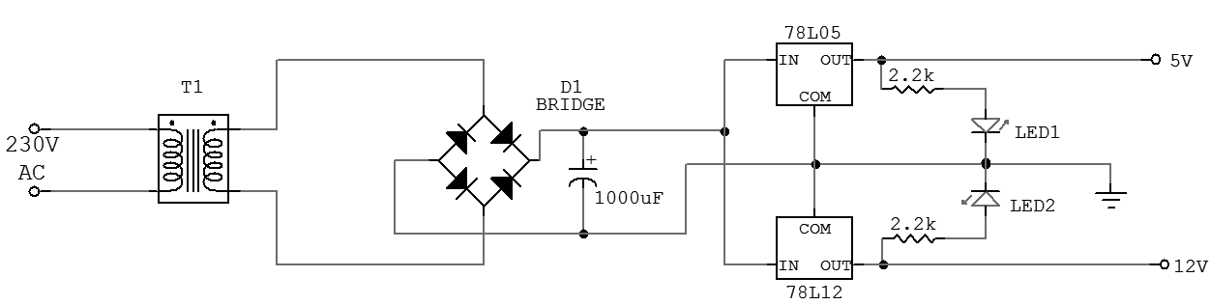
POWER SUPPLY
A power supply is an electronic device that supplies Electric energy to an electrical load.

Slide 10
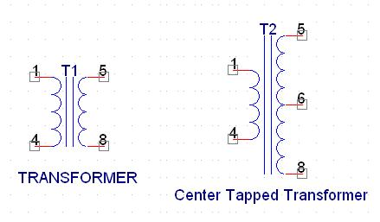
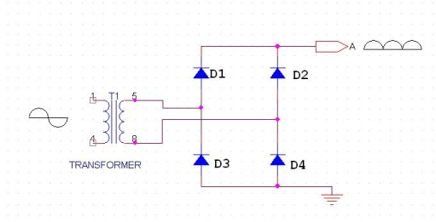
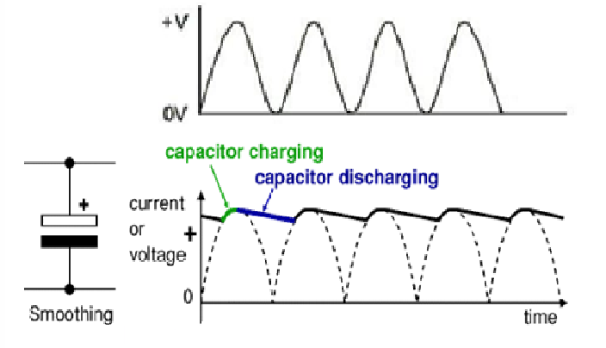
Components in Power Supply
Transformer
Rectifier
1) Half Wave rectifier:
2) Full wave rectifier:
3) Bridge rectifier:
Filter capacitor
Regulators:
It is a device which converts varying input voltage into a constant regulated output voltage.

Slide 11
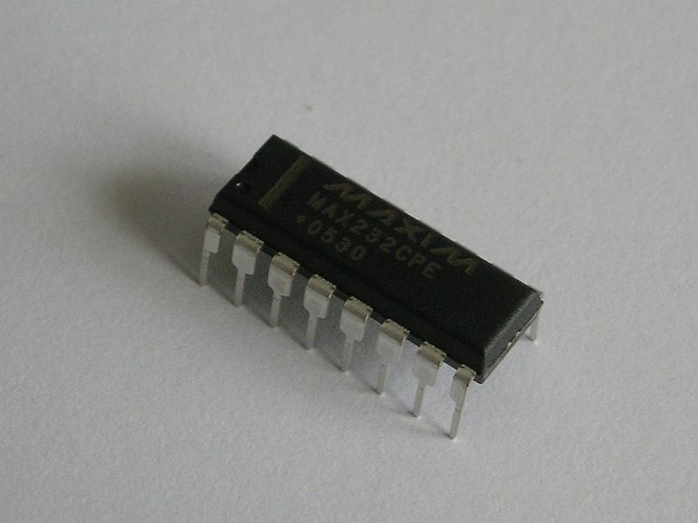
MAX232
DCF The MAX232 is an integrated circuit first created in 1987 by Maxim Integrated Products that converts signals from a TIA-232 (RS-232) serial port to signals suitable for use in TTL compatible digital logic circuits. The MAX232 is a dual driver/receiver and typically converts the RX, TX, CTS and RTS signals.

Slide 12
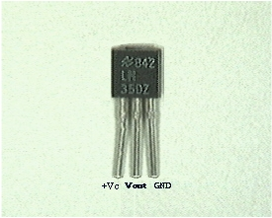
TEMPERATURE SENSOR
The LM35 series are precision integrated-circuit temperature sensors, whose output voltage is linearly proportional to the Celsius (Centigrade) temperature.
LM35 has an advantage over kelvin calibrated sensors as the users, are not required to subtract a large constant voltage from its output to obtain convenient centigrade scaling .
The LM35 does not require any external calibration or trimming to provide typical accuracies of ±¼°C at room temperature and ±¾°C over a full -55 to +150°C temperature range. Low cost is assured by trimming and calibration at the wafer level.

Slide 13
FEATURES
Calibrated directly in ° Celsius (Centigrade)
Linear + 10.0 mV/°C scale factor
0.5°C accuracy guarantee able (at +25°C)
Rated for full -55° to +150°C range
Suitable for remote applications
Low cost due to wafer-level trimming
Operates from 4 to 30 volts
Less than 60 µA current drain
Low self-heating, 0.08°C in still air
Non-linearity only ±¼°C typical
Low impedance output, 0.1 Ohm for 1 mA load

Slide 14
LDR(LIGHT DEPENDENT RESISTOR)
A photo resistor or Light Dependent Resistor or CDS Cell is a resistor whose resistance decreases with increasing incident light intensity. It can also be referred to as a photoconductor
A photo resistor is made of a high resistance semiconductor. If light falling on the device is of high enough frequency, photons absorbed by the semiconductor give bound electrons enough energy to jump into the conduction band.
The resulting free electron (and its hole partner) conduct electricity, thereby lowering resistance.

Slide 15
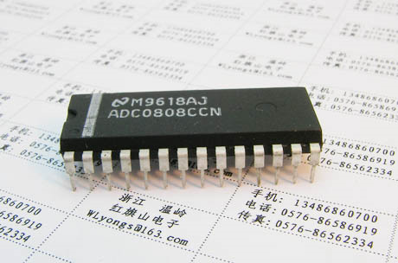
ADC0808
The ADC0808, ADC0809 data acquisition component is a monolithic CMOS device with an 8-bit analog-to-digital converter, 8-channel multiplexer and microprocessor compatible control logic.
The 8-channel multiplexer can directly access any of 8-single-ended analog signals. The device eliminates the need for external zero and full-scale adjustments.
Easy interfacing to microprocessors is provided by the latched and decoded multiplexer address inputs and latched TTL TRI-STATE outputs

Slide 16
555TIMER
"555" integrated circuit is used for time-delay and oscillator functions. In the time-delay or monostable mode of operation, the timed interval is controlled by a single external resistor and capacitor network.
In the astable mode of operation, the frequency and duty cycle may be independently controlled with two external resistors and a single external capacitor.
The threshold and trigger levels are normally two-thirds and one-third, respectively, of VCC. These levels can be altered by use of the control voltage terminal

Slide 17
FLOW CHART

Slide 18
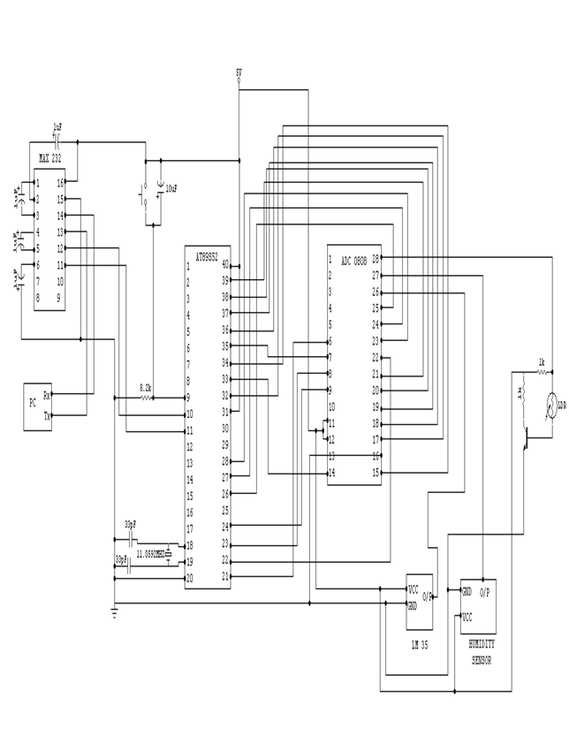
CIRCUIT DIAGRAM

Slide 19
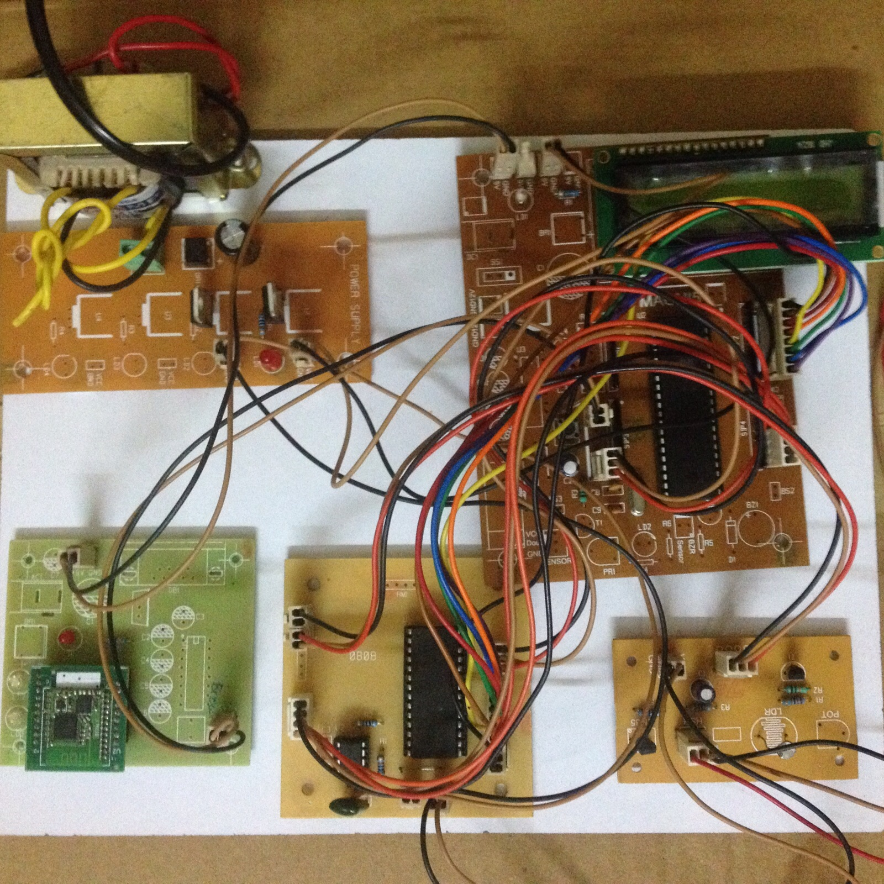
RESULT

Slide 20
APPLICATIONS
Temperature monitoring
Wireless technologies
Home Automation
Mobile home automation
Industrial applications
Humidity sensing

Slide 21
ADVANTAGES / DISADVANTAGES
ADVANTAGES
LOW COST
LESS COMPLEXITY
THIS SYSTEM DOES NOT DEPEND ON ANY NETWORK.
BY USING THIS METHOD WE CAN MONITOR TEMPERATURE AND LIGTH INTENSITY.
DISADVANTAGES
RS232 CAN TRANSFER DATA TO ONLY SHORT DISTANCES.

Slide 22
THANK YOU

